Slide 1
Persistence & Transactions
Topping the Source of Pure Knowledge

Slide 2
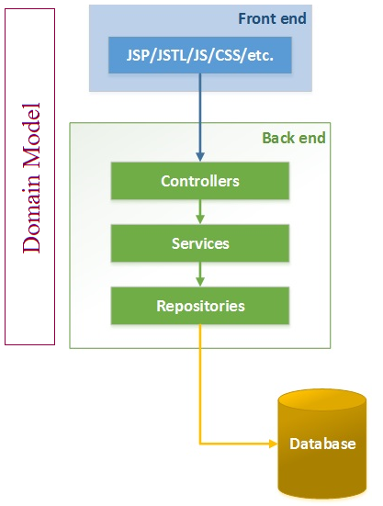
N-Tier Architecture - Spring MVC Layers
Presentation [View & Controller] Tier
  Communication interface to external entities
  “View” in the model-view-controller
Business [Services] Tier
  Implements operations requested by clients through the presentation layer
  Represents the “business logic”
Persistence [Repository] Tier
  Deals with different data sources of an information system
  Responsible for storing and retrieving data
Notes:
Layered
Discrete responsibilities for different layers
Separation of Concerns

Slide 3
Service Tier “manages” Persistence
All access to Persistence through Services
Services responsible for business Logic and data model composition
  Business logic does NOT belong in Persistence
  Business logic does NOT belong in Presentation
Spring/JPA/Persistence is designed with this architecture
Notes:
See examples service Component use cases
WAA/Bruen/New/servicecomponentusecases

Slide 4
Object Relational Mapping
In an application we want to focus on business concepts, not on the relational database structure
Abstract from the “by-hand” communication with the DB (e.g., via JDBC)
Allow for an automatic synchronization between Java Objects and the underlying database
Portability
  ORM should be mostly DB independent (with the exception of some types of features, such as identifier generation)
  Query abstractions using e.g. JPQL or HQL - the vendor specific SQL is auto-generated
Performance
  Object and query caching is automatically done by the ORM

Slide 5
Java Persistence API
JPA is a specification – not an implementation.
JPA 1.0 (2006). JPA 2.0 (2009).
Standardizes interface across industry platforms
Object/Relational Mapping
  Specifically Persistence for RDBMS
Major Implementations [since 2006]:
  Toplink - Oracle implementation [donated to Eclipse foundation for merge with Eclipselink 2008]
  Hibernate - Most deployed framework. Major contributor to JPA specification.
  OpenJPA - (openjpa.apache.org) which is an extension of Kodo implementation.
Notes:
JPA 2.2[edit]
Development of a maintenance release as JPA 2.2 was started in 2017 under JSR 338. The maintenance review was approved on 19 Jun, 2017.
Main features included were:
Add @Repeatable to all relevant annotations
Allow all JPA annotations to be used in meta-annotations.
Add ability to stream a query result
Allow AttributeConverters to be CDI injectable
Support Java 8 Date and Time types
Vendors supporting JPA 2.2
DataNucleus
EclipseLink (from version 2.7)
Hibernate (from version 5.3)

Slide 6
JPA ORM Fundamentals
Entity
  lightweight persistence domain object
  Annotation driven Entities - @Entity
Persistence Context ~= Session in Hibernate
  Like cache which contains a set of persistent entities
  Within the persistence context, the entity instances and their lifecycle are managed.
EntityManager
  Basically a CRUD Service -- { persist, find, remove}.
  Can Find entities by their primary key, and to query over all entities.
  Can participate in a transaction.
Transaction Manager
  Java Transaction API
  General API for managing transactions in Java
  Start, Close, Commit, Rollback operations
Notes:
EntityManager：
Interface used to interact with the persistence context.
An EntityManager instance is associated with a persistence context. A persistence context is a set of entity instances in which for any persistent entity identity there is a unique entity instance. Within the persistence context, the entity instances and their lifecycle are managed. This interface defines the methods that are used to interact with the persistence context. The EntityManager API is used to create and remove persistent entity instances, to find entities by their primary key, and to query over entities.
Persistence Context:
A Cache is a copy of data, copy meaning pulled from but living outside the database.
Flushing a Cache is the act of putting modified data back into the database.
Which it means the connection to the database and entities are managed by the EntityManager, but the object that open an close transaction in the service layer using the @Transaction annotation is the TransactionManager.
manage entities and operate with them use entitymanager, control the transactional state of your application by yourself use the transactionmanager.
https://stackoverflow.com/questions/27049874/what-is-the-difference-between-transaction-manager-and-entity-manager
https://www.thoughts-on-java.org/jpa-generate-primary-keys/
http://www.coderpanda.com/jpa-tutorial/

Slide 7
Entity
Are POJOs (Plain Old Java Objects)
Lightweight persistent domain object
Typically represent a table in a relational database
Each entity instance corresponds to one row in that table
Have a persistent identity
May have both, persistent and transient (non-persistent) state
  Simple types (primitive data types, wrappers, enums)
  Composite types (e.g., Address)
  Non-persistent state (using identifier transient or @Transient annotation)

Slide 8
JPA ORM Fundamentals
Entity
  lightweight persistence domain object
  Annotation driven Entities - @Entity
Persistence Context ~= Session in Hibernate
  Like cache which contains a set of persistent entities
  Within the persistence context, the entity instances and their lifecycle are managed.
EntityManager
  Basically a CRUD Service -- { persist, find, remove}.
  Can Find entities by their primary key, and to query over all entities.
  Can participate in a transaction.
Transaction Manager
  Java Transaction API
  General API for managing transactions in Java
  Start, Close, Commit, Rollback operations
Notes:
EntityManager：
Interface used to interact with the persistence context.
An EntityManager instance is associated with a persistence context. A persistence context is a set of entity instances in which for any persistent entity identity there is a unique entity instance. Within the persistence context, the entity instances and their lifecycle are managed. This interface defines the methods that are used to interact with the persistence context. The EntityManager API is used to create and remove persistent entity instances, to find entities by their primary key, and to query over entities.
Persistence Context:
A Cache is a copy of data, copy meaning pulled from but living outside the database.
Flushing a Cache is the act of putting modified data back into the database.
Which it means the connection to the database and entities are managed by the EntityManager, but the object that open an close transaction in the service layer using the @Transaction annotation is the TransactionManager.
manage entities and operate with them use entitymanager, control the transactional state of your application by yourself use the transactionmanager.
https://stackoverflow.com/questions/27049874/what-is-the-difference-between-transaction-manager-and-entity-manager
https://www.thoughts-on-java.org/jpa-generate-primary-keys/
http://www.coderpanda.com/jpa-tutorial/

Slide 9
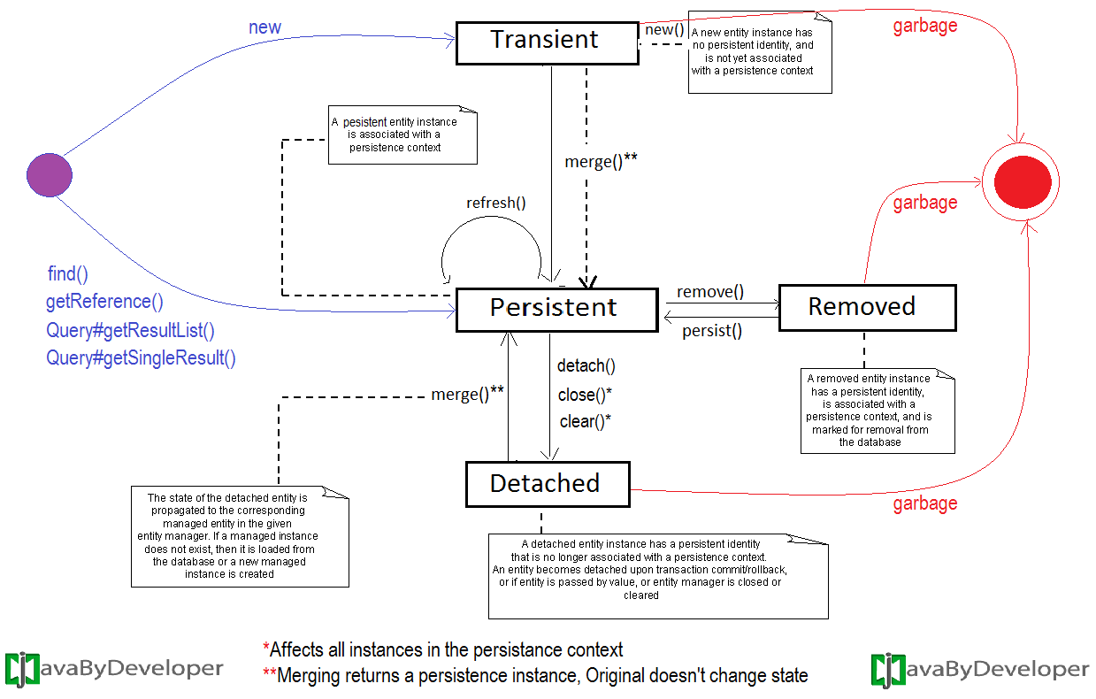
Entity Lifecycle
Notes:
https://javabydeveloper.com/jpa-entity-lifecycle-jpa-developer-should-know/

Slide 10
JPA ORM Fundamentals
Entity
  lightweight persistence domain object
  Annotation driven Entities - @Entity
Persistence Context ~= Session in Hibernate
  Like cache which contains a set of persistent entities
  Within the persistence context, the entity instances and their lifecycle are managed.
EntityManager
  Basically a CRUD Service -- { persist, find, remove}.
  Can Find entities by their primary key, and to query over all entities.
  Can participate in a transaction.
Transaction Manager
  Java Transaction API
  General API for managing transactions in Java
  Start, Close, Commit, Rollback operations
Notes:
EntityManager：
Interface used to interact with the persistence context.
An EntityManager instance is associated with a persistence context. A persistence context is a set of entity instances in which for any persistent entity identity there is a unique entity instance. Within the persistence context, the entity instances and their lifecycle are managed. This interface defines the methods that are used to interact with the persistence context. The EntityManager API is used to create and remove persistent entity instances, to find entities by their primary key, and to query over entities.
Persistence Context:
A Cache is a copy of data, copy meaning pulled from but living outside the database.
Flushing a Cache is the act of putting modified data back into the database.
Which it means the connection to the database and entities are managed by the EntityManager, but the object that open an close transaction in the service layer using the @Transaction annotation is the TransactionManager.
manage entities and operate with them use entitymanager, control the transactional state of your application by yourself use the transactionmanager.
https://stackoverflow.com/questions/27049874/what-is-the-difference-between-transaction-manager-and-entity-manager
https://www.thoughts-on-java.org/jpa-generate-primary-keys/
http://www.coderpanda.com/jpa-tutorial/

Slide 11
An Entity’s Object States Relationship with the ORM Persistence Context
New, or Transient - the entity has just been instantiated and is not associated with a persistence context. It has no persistent representation in the database and no identifier value has been assigned.
Managed, or Persistent - the entity has an associated identifier and is associated with a persistence context.
Detached - the entity has an associated identifier, but is no longer associated with a persistence context (usually because the persistence context was closed or the instance was evicted from the context).
Removed - the entity has an associated identifier and is associated with a persistence context, however it is scheduled for removal from the database.

Slide 12
JPA ORM Fundamentals
Entity
  lightweight persistence domain object
  Annotation driven Entities - @Entity
Persistence Context ~= Session in Hibernate
  Like cache which contains a set of persistent entities
  Within the persistence context, the entity instances and their lifecycle are managed.
EntityManager
  Basically a CRUD Service -- { persist, find, remove}.
  Can Find entities by their primary key, and to query over all entities.
  Can participate in a transaction.
Transaction Manager
  Java Transaction API
  General API for managing transactions in Java
  Start, Close, Commit, Rollback operations
Notes:
EntityManager：
Interface used to interact with the persistence context.
An EntityManager instance is associated with a persistence context. A persistence context is a set of entity instances in which for any persistent entity identity there is a unique entity instance. Within the persistence context, the entity instances and their lifecycle are managed. This interface defines the methods that are used to interact with the persistence context. The EntityManager API is used to create and remove persistent entity instances, to find entities by their primary key, and to query over entities.
Persistence Context:
A Cache is a copy of data, copy meaning pulled from but living outside the database.
Flushing a Cache is the act of putting modified data back into the database.
Which it means the connection to the database and entities are managed by the EntityManager, but the object that open an close transaction in the service layer using the @Transaction annotation is the TransactionManager.
manage entities and operate with them use entitymanager, control the transactional state of your application by yourself use the transactionmanager.
https://stackoverflow.com/questions/27049874/what-is-the-difference-between-transaction-manager-and-entity-manager
https://www.thoughts-on-java.org/jpa-generate-primary-keys/
http://www.coderpanda.com/jpa-tutorial/

Slide 13
Transaction Management
Persistence Context ~= Session
Spring “manages” through @Transactional
Unit of work
START –
Open a Session
Open a single database connection
Start a Transaction
Do the Work –
Associate & Manage entities W/R the session
Exercise DB CRUD operations
END –
End Transaction
Close a Session
@Service
@Transactional
public class ProductServiceImpl implements ProductService{
public Product getProductById(Long productID) {
return productRepository.findOne(productID);
}
}
Open Session/Start Transaction when method is called
Close Session/End Transaction when method is exited
Notes:
https://www.cnblogs.com/wangkai1990/p/5704529.html
https://blog.csdn.net/oscar999/article/details/55213354
SessionFactory sf = new Configuration().configure().buildSessionFactory() ;
Session s = sf.openSession();
Person person = new Person();
Transaction tran = s.beginTransaction(); (1)
s.save(person); (2)（此处同样可以为update delete）
s.evict(person); (3)
tran.commit(); (4)
s.close();(5)
session-per-request-with-detached-objects
https://stackoverflow.com/questions/1069992/jpa-entitymanager-why-use-persist-over-merge
https://stackoverflow.com/questions/19930152/what-is-persistence-context
http://docs.jboss.org/hibernate/core/4.0/devguide/en-US/html/ch03.html
http://docs.jboss.org/hibernate/entitymanager/3.5/reference/en/html/architecture.html

Slide 14
Cascade and Fetch
Configurable Parent-Child operations
Cascade Types
  ALL, PERSIST, MERGE, REMOVE, REFRESH, DETACH
  Default is none
  Persist
    If the parent is persisted so are the children
  Remove
    If the parent is “removed” so are the children
  Merge [ a detatched object]
    If the parent is merged so are the children
      Merge modifications made to the detached object are merged into a corresponding DIFFERENT managed object
Fetching Strategies
  Define how object hierarchies are loaded
  EAGER = load all related objects immediately
  LAZY = load the related objects only if they are accessed for the first time
  Be careful with EAGER, as large object graphs may be loaded unintentionally

Slide 15
ORM Relationships
One-to-One
One-to-Many
Many-to-Many
Unidirectional - Bidirectional

Slide 16
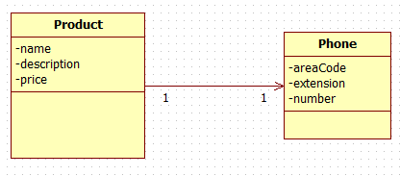
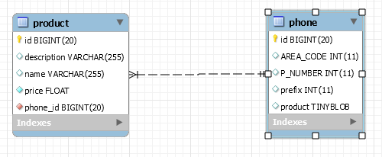
OneToOne Unidirectional
hotLine

Slide 17
OneToOne Unidirectional
@Entity
public class Product implements Serializable {
  @Id
  @GeneratedValue(strategy=GenerationType.AUTO)
  private long id;
  private String name;
  private String description;
  private float price;
  @OneToOne(cascade = CascadeType.ALL)
  @JoinColumn(name = "phone_id", nullable = false)
  private Phone hotLine;
}
@Entity
public class Phone implements Serializable {
  @Id
  @GeneratedValue(strategy=GenerationType.AUTO)
  private long id;
  private Integer areacode;
  private Integer number;
  private Integer prefix;
}

Slide 18
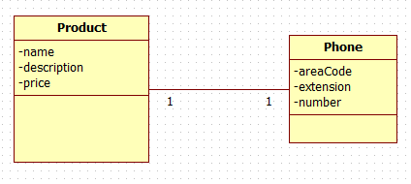
OneToOne Bi-directional
hotLine

Slide 19
OneToOne Bi-directional
Annotation the OTHER side of the relationship ALSO…
@Entity
public class Product implements Serializable {
  @Id
  @GeneratedValue(strategy=GenerationType.AUTO)
  private long id;
  private String name;
  private String description;
  private float price;
  @OneToOne(cascade = CascadeType.ALL)
  @JoinColumn(name = "phone_id", nullable = false)
  private Phone hotLine;
}
@Entity
public class Phone implements Serializable {
  @Id
  @GeneratedValue(strategy = GenerationType.AUTO)
  private long id;
  private Integer areacode;
  private Integer number;
  private Integer prefix;
  @OneToOne(mappedBy = "hotLine", cascade = CascadeType.ALL)
  private Product product;
}
mappedBy – use the foreign key and mapping
in the source to define the target mapping
Notes:
One-one CAN have N+1 problem

Slide 20
Bi-directional Relationships
WARNING NOTICE
If you add or remove to one side of the collection, you must also add or remove from the other side
Database will be updated correctly ONLY if you add/remove from the owning side of the relationship
Your object model can get out of sync if you do not pay attention…

Slide 21
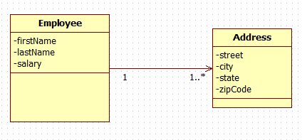
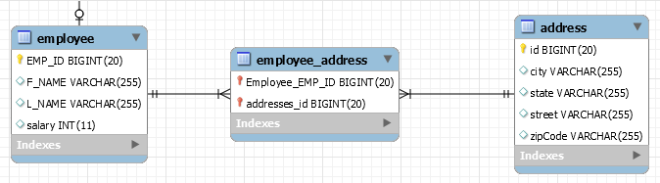
One-to-Many Join Table
addresses

Slide 22
OneToMany Unidirectional JoinTable
@Entity
@Table(name = "employee")
public class Employee implements Serializable {
  @Id
  @GeneratedValue(strategy = GenerationType.AUTO)
  @Column(name = "EMP_ID")
  private long id;
  @Column(name = "F_NAME")
  private String firstName;
  @Column(name = "L_NAME")
  private String lastName;
  private Integer salary;
  @OneToMany(cascade = CascadeType.ALL)
  // FetchMode.JOIN will do eager load also
  @Fetch(FetchMode.JOIN)
  private List<Address> addresses;
}
@Entity
public class Address implements Serializable {
  @Id
  @GeneratedValue(strategy = GenerationType.AUTO)
  private long id;
  private String street;
  private String city;
  private String state;
  private String zipCode;
}
This is the Default

Slide 23
OneToMany Bidirectional JoinTable
OneToMany side same as unidirectional example
Simply Add ManyToOne on child object
@Entity
@Table(name = "emp")
public class Employee implements Serializable {
  @Id
  @GeneratedValue(strategy = GenerationType.AUTO)
  @Column(name = "EMP_ID")
  private long id;
  @Column(name = "F_NAME")
  private String firstName;
  @OneToMany(cascade = CascadeType.ALL)
  // FetchMode.JOIN will do eager load also
  @Fetch(FetchMode.JOIN)
  private List<Address> addresses;
}
@Entity
public class Address implements Serializable {
  @Id
  @GeneratedValue(strategy = GenerationType.AUTO)
  private long id;
  private String street;
  private String city;
  private String state;
  private String zipCode;
  @ManyToOne
  private Employee employee;
}

Slide 24
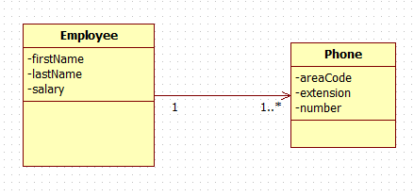
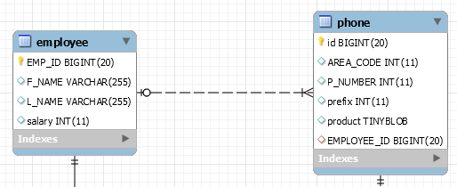
OneToMany Unidirectional JoinColumn
phones

Slide 25
OneToMany Unidirectional JoinColumn
@Entity
@Table(name = "emp")
public class Employee implements Serializable {
  @Id
  @GeneratedValue(strategy = GenerationType.AUTO)
  @Column(name = "EMP_ID")
  private long id;
  @Column(name = "F_NAME")
  private String firstName;
  @OneToMany(cascade = CascadeType.ALL)
  @Fetch(FetchMode.JOIN)
  @JoinColumn(name = "EMPLOYEE_ID")
  private List<Phone> phones;
}
@Entity
public class Phone implements Serializable {
  @Id
  @GeneratedValue(strategy=GenerationType.AUTO)
  private long id;
  private Integer areacode;
  private Integer number;
  private Integer prefix;
}
HIBERNATE REFERENCE DOC:
A unidirectional one-to-many association on a foreign key is an unusual case, and is not recommended. You should instead use a join table for this kind of association.

Slide 26
OneToMany Bi-directional JoinColumn
@Entity
@Table(name = "emp")
public class Employee implements Serializable {
  @Id
  @GeneratedValue(strategy = GenerationType.AUTO)
  @Column(name = "EMP_ID")
  private long id;
  @Column(name = "F_NAME")
  private String firstName;
  @OneToMany(cascade = CascadeType.ALL, mappedBy = "employee")
  private List<Phone> phones;
}
@Entity
public class Phone implements Serializable {
  @Id
  @GeneratedValue(strategy = GenerationType.AUTO)
  private long id;
  private Integer areacode;
  private Integer number;
  private Integer prefix;
  @ManyToOne
  @JoinColumn(name = "EMP_ID")
  private Employee employee;
}
Owns relationship

Slide 27
Many-to-Many
1..*

Slide 28
Many-To-Many
@Entity
@Table(name = "emp")
public class Employee implements Serializable {
  @Id
  @GeneratedValue(strategy = GenerationType.AUTO)
  @Column(name = "EMP_ID")
  private long id;
  @ManyToMany(cascade = { CascadeType.ALL })
  @JoinTable()
  Set<Project> projects = new HashSet<>();
}
@Entity
public class Project implements Serializable{
  @Id
  @GeneratedValue(strategy = GenerationType.AUTO)
  private long id;
  private String name;
  @ManyToMany(mappedBy = "projects")
  private Set<Employee> employees = new HashSet<>();
}
If Converting from OneToMany [Join table] – The ManyToMany is achieved by simply dropping the unique constraint on the JoinTable created by OneToMany

Slide 29
Main Point
JPA is a specification not an implementation. It provides a consistent, reliable mechanism for data storage and retrieval that alleviates the application developer from the details involved in the persistence layer.
The mechanism of transcending allows the individual to tap into Transcendental Consciousness and enlivens its qualities in activity.

Slide 30
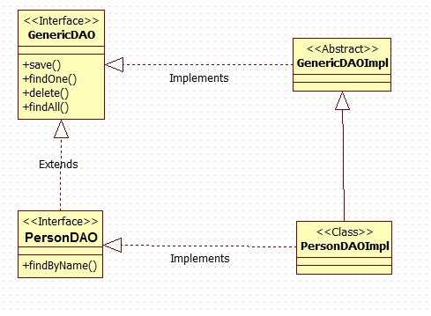
“Classic” ORM GenericDAO
Generic types
Adds Domain Object specific functionality
Notes:
SPRING DATA == ProductDAO Interface

Slide 31
Spring Version of DAO
@Repository
public interface PhoneRepository extends CrudRepository<Phone, Long> {
}

Slide 32
Spring Data
Spring Data
  High level SpringSource project whose purpose is to unify and ease the access to different kinds of persistence stores, both relational database systems and NoSQL data stores.
Hibernate ORM
  (Hibernate for short) is an object-relational mapping Java library;
  a framework for mapping an object-oriented domain model to a traditional relational database. Distributed under the GNU Lesser (General Public License).
Notes:
JBOSS- Hibernate
Pivotal – Spring/Tomcat

Slide 33
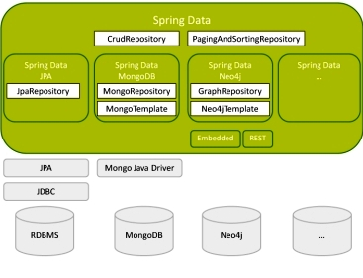
Spring Data Project
Notes:
https://en.wikipedia.org/wiki/NoSQL#Types_and_examples_of_NoSQL_databases

Slide 34
Spring Data Repositories
Spring Data repository abstraction
Significantly reduce the amount of boilerplate code required to implement data access layers
Domain Object specific wrapper that provides capabilities on top of EntityManager
Performs function of a Base Class DAO
Three Types:
  CrudRepository: provides CRUD functions.
  PagingAndSortingRepository: provide methods to do pagination and sorting records.
  JpaRepository: provides methods such as flushing the persistence context and delete record in a batch.

Slide 35
Wiring the Components (XML)
<bean id="entityManager"
class="org.springframework.orm.jpa.LocalContainerEntityManagerFactoryBean">
  <property name="dataSource" ref="dataSource" />
  <property name="packagesToScan" value="edu.mum.domain" />
  <property name="jpaVendorAdapter">
  <bean class="org.springframework.orm.jpa.vendor.HibernateJpaVendorAdapter" />
  </property>
  <property name="jpaProperties">
    <props>
    <prop key="hibernate.hbm2ddl.auto">create</prop>
    <prop key="hibernate.dialect">org.hibernate.dialect.MySQL5Dialect</prop>
    </props>
  </property>
</bean>
<bean id="transactionManager" class="org.springframework.orm.jpa.JpaTransactionManager">
<property name="entityManagerFactory" ref="entityManager" />
</bean>

Slide 36
Wiring Continued
Scan for interfaces extending Repository
<jpa:repositories base-package="com.packt.webstore.domain.repository"/>
Scan for transaction-based resources
<context:component-scan base-package= "com.packt.webstore.service" />
<context:component-scan base-package= "com.packt.webstore.repository"/>
<tx:annotation-driven transaction-manager="transactionManager"/>
Notes:
Using this element looks up Spring Data repositories as described in Section 1.2.3, “Creating repository instances”. Beyond that it activates persistence exception translation for all beans annotated with @Repository to let exceptions being thrown by the JPA presistence providers be converted into Spring's DataAccessExceptionhierarchy.

Slide 37
Wiring the Components (Java Config)
@Configuration
@EnableTransactionManagement
@EnableJpaRepositories(basePackages = { "edu.mum.repository" })
public class RootApplicationContextConfig {
  @Bean
  public EntityManagerFactory entityManagerFactory() {
    HibernateJpaVendorAdapter vendorAdapter = new HibernateJpaVendorAdapter();
    vendorAdapter.setGenerateDdl(true);
    LocalContainerEntityManagerFactoryBean factory = new LocalContainerEntityManagerFactoryBean();
    factory.setJpaVendorAdapter(vendorAdapter);
    factory.setPackagesToScan("edu.mum.domain");
    factory.setDataSource(dataSource());
    factory.afterPropertiesSet();
    factory.setJpaProperties(additionalProperties());
    return factory.getObject();
  }
  @Bean
  public PlatformTransactionManager transactionManager() {
    JpaTransactionManager txManager = new JpaTransactionManager();
    txManager.setEntityManagerFactory(entityManagerFactory());
    return txManager;
  }
}

Slide 38
Spring Boot Configuration
No – if follow standard, in-memory database
Not in-memory databse configuration
  spring.jpa.hibernate.ddl-auto=create
  spring.datasource.url=jdbc:mysql://localhost:3306/boot_onetoone
  spring.datasource.username=root
  spring.datasource.password=root
  #spring.jpa.database-platform=org.hibernate.dialect.MySQLDialect
  spring.datasource.driver-class-name=com.mysql.jdbc.Driver

Slide 39
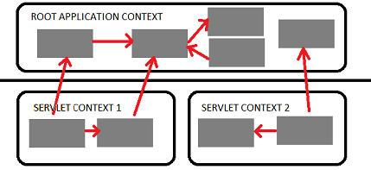

Web Application Context
Spring has multilevel application context hierarchies.
Web apps by default have two hierarchy levels, root and servlet contexts:
Presentation tier has a WebApplicationContext
[Servlet Context] which inherits all the resources already defined in the root ApplicationContext [ Services, Persistence]
RootApplicationContext
WebApplicationContext
Presentation tier

Slide 40
Spring DAO
@Service
@Transactional
public class PhoneServiceImpl implements PhoneService {
  @Autowired
  PhoneRepository phoneRepository;
  public List<Phone> getAll() {
  return (List<Phone>) phoneRepository.findAll();
  }
  public Phone save(Phone phone) {
  return phoneRepository.save(phone);
  }
}
@Repository
public interface PhoneRepository extends CrudRepository<Phone, Long> {
}

Slide 41
CrudRepository
public interface CrudRepository<T, ID> extends Repository<T, ID> {
  <S extends T> S save(S entity);
  <S extends T> Iterable<S> saveAll(Iterable<S> entities);
  Optional<T> findById(ID id);
  boolean existsById(ID id);
  Iterable<T> findAll();
  Iterable<T> findAllById(Iterable<ID> ids);
  long count();
  void deleteById(ID id);
  void delete(T entity);
  void deleteAll(Iterable<? extends T> entities);
  void deleteAll();
}
LOOKS just Like [what is Known as] a “genericDAO interface”
HOWEVER, Spring provides [default] implementations – effectively Java 8-like default methods in an interface

Slide 42
Spring Data Repository Query Resolution
Query examples - CREATE example
CREATE example
  attempts to construct a store-specific query from the query method name.
  The name of our query method must start with one of the following prefixes: find…By, read…By, query…By, count…By, and get…By.
  limit the number of returned query results: findTopBy, findTop8By, findFirstBy, and findFirst8By
  select unique results: findTitleDistinctBy or findDistinctTitleBy
  @Repository
  public interface PhoneRepository extends CrudRepository<Phone, Long> {
    public List<Phone> findByAreacodeOrPrefix(String areacode, String prefix);
    public long countByAreacode(String areacode);
  }
Query Key Words
Query lookup strategies

Slide 43
JPQL - Data Object Queries
JPQL is similar to SQL, but operates on objects, attributes and relationships instead of tables and columns.
  @Entity
  public class Product implements Serializable {
    private String name;
    @OneToOne(cascade = CascadeType.ALL)
    private Phone hotLine;
  }
JPQL:
  SELECT p FROM Product p
Will Yield:
  Product with Phone;
Where:
  product.getHotLine().getNumber(); is populated
NOTE: JPA OneToOne relationship defaults to eager

Slide 44
Spring Data Repository Query Resolution
Query examples - USE_DECLARED_QUERY
USE_DECLARED_QUERY
  tries to find a declared query and will throw an exception in case it can’t find one.
JPQL Queries
@Query(value = "SELECT e FROM Employee e WHERE e.lastName = :lastname")
public List<Employee> findByLastName(String lastname);
SQL Queries
@Query(value = "SELECT * FROM emp e WHERE e.F_NAME = ?1", nativeQuery = true)
public List<Employee> findByFirstName(String firstName);
CLASS LEVEL DECLARED
public final static String FIND_BY_SALARY_QUERY = "SELECT e FROM Employee e WHERE e.salary = :salary";
@Query(FIND_BY_SALARY_QUERY)
public List<Employee> findByAddress(@Param("salary") Integer salary);
Notes:
Using Like: select ... like :username
List<User> findByUsernameLike(String username);
StartingWith: select ... like :username%
List<User> findByUsernameStartingWith(String username);
EndingWith: select ... like %:username
List<User> findByUsernameEndingWith(String username);
Containing: select ... like %:username%
List<User> findByUsernameContaining(String username);
Employee

Slide 45
Spring Data Repository Query Resolution
Query examples - JPA Named Query
Declaration:
@Entity
@Table(name = "emp")
@NamedQuery(name = "Employee.findEmployeesByLastName", query = "SELECT e FROM Employee e WHERE LOWER(e.lastName) = LOWER(:lastName)")
public class Employee implements Serializable {
}
Query name convention: @{EntityName}.{queryName}
Usage:
@Repository
public interface EmployeeRepository extends CrudRepository<Employee, Long> {
  public List<Employee> findEmployeesByLastName(@Param("lastName") String lastName);
}

Slide 46
Main Point
Spring provides a Transactional capability for ORM applications.
The mechanism of transcending allows the individual to tap into Transcendental Consciousness and enlivens its qualities in activity.

